Slide 1

DATABASE PROJECT
Football Teams Database

Slide 2
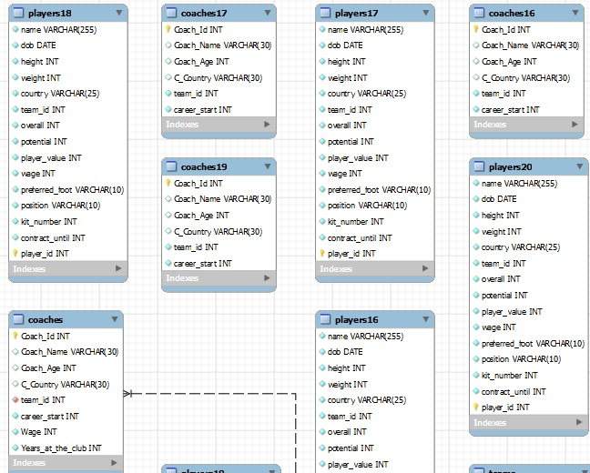
ERD

Slide 3
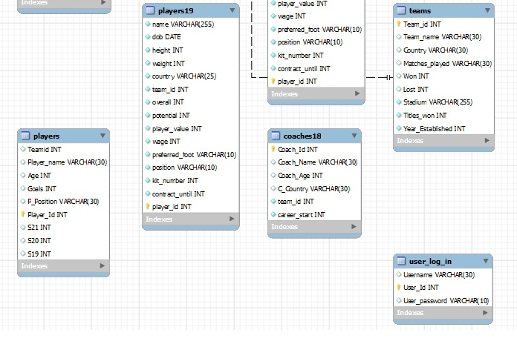
ERD

Slide 4
MEMBERS
ZAID BIN USAMA BHATTI 356844
AHMAD TASHFEEN 345308
AIMAN KHAQAN 334232

Slide 5
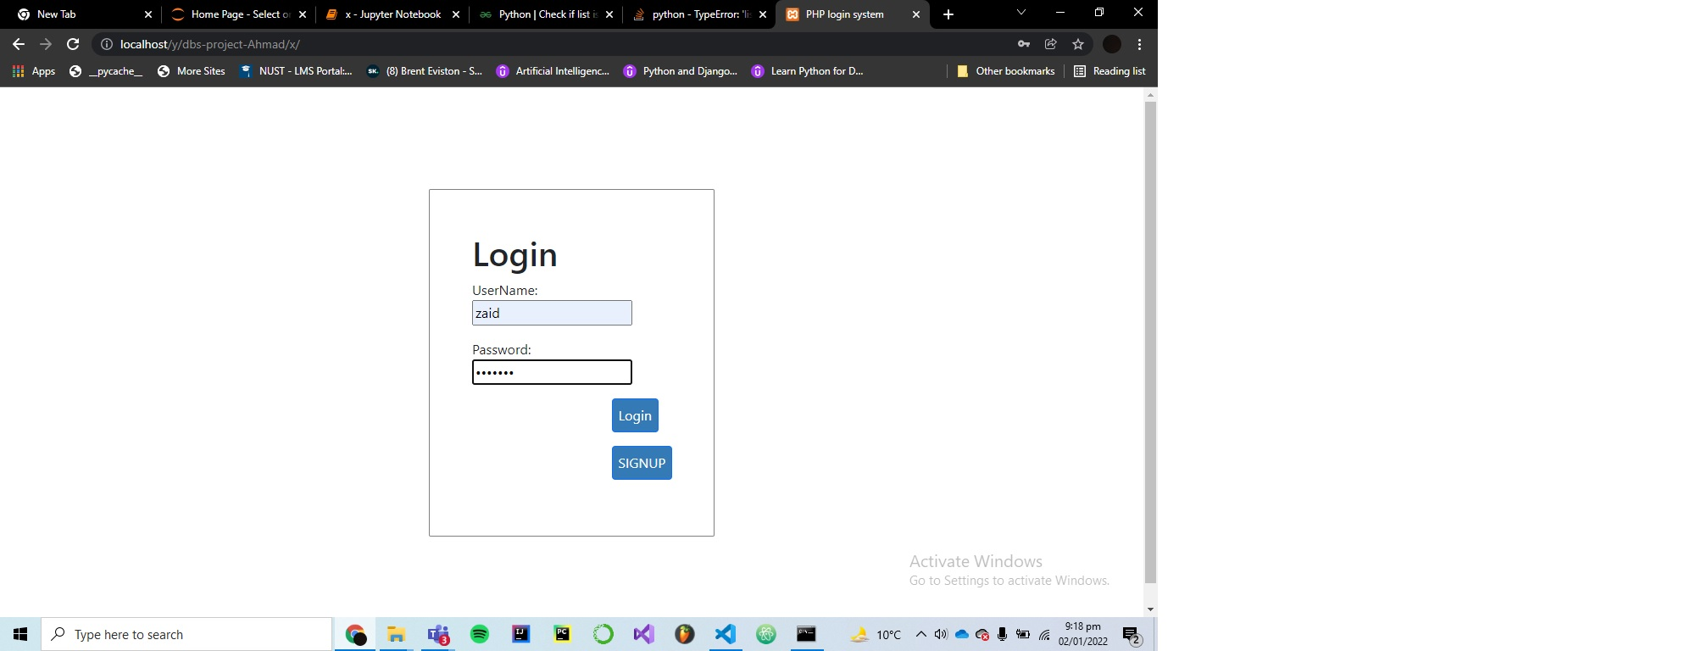
LOGIN PAGE

Slide 6
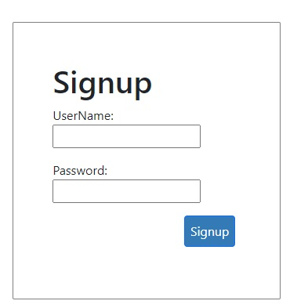
SIGN UP PAGE

Slide 7
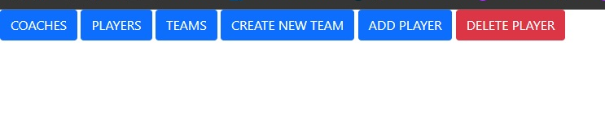
CONTENT PAGE

Slide 8
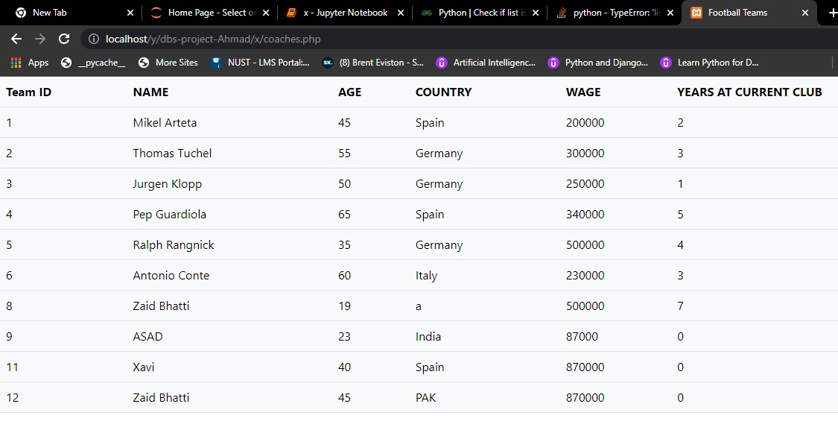
COACH PAGE

Slide 9
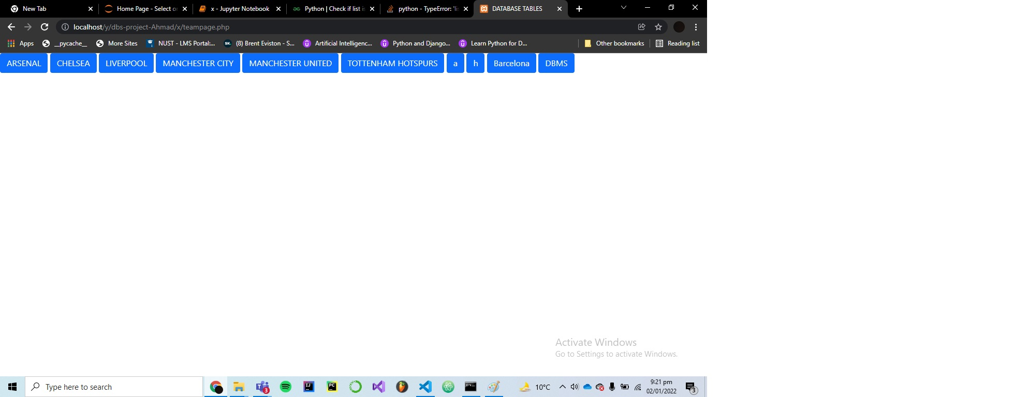
PLAYERS TEAM PAGE
We have used ‘Arsenal’ as an example to navigate among the players:
The following two slides demonstrate how to view players for a specific team and year

Slide 10
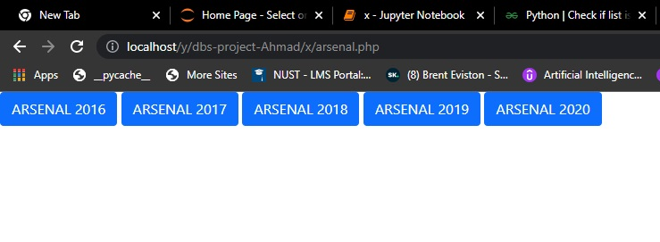
Team yearly page

Slide 11
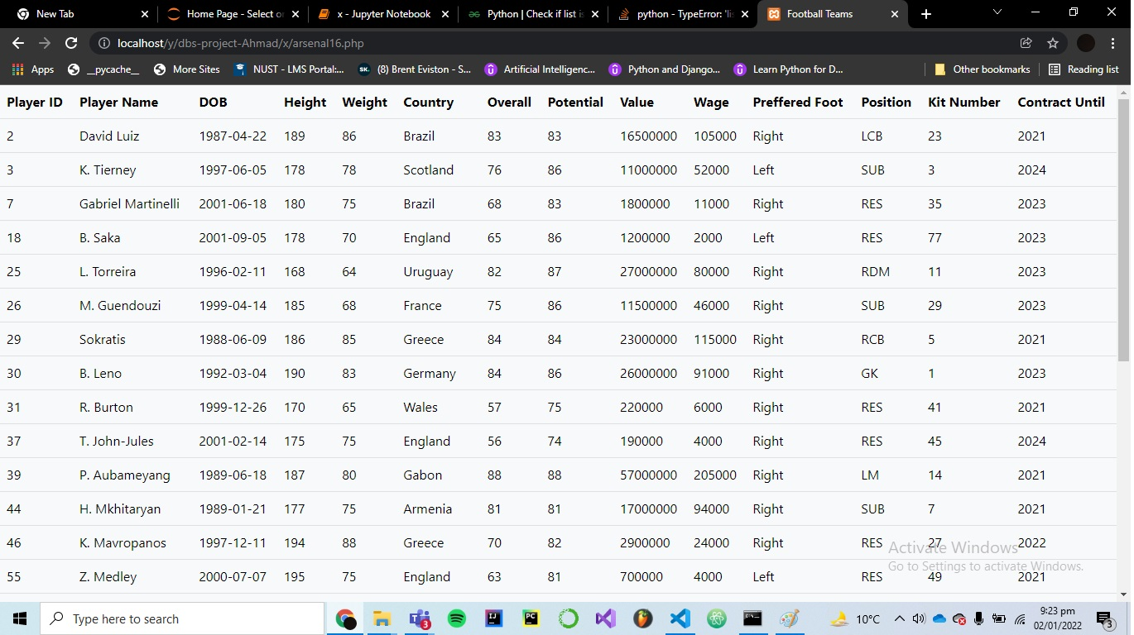
Team Players by Year

Slide 12
Team Players by Year

Slide 13
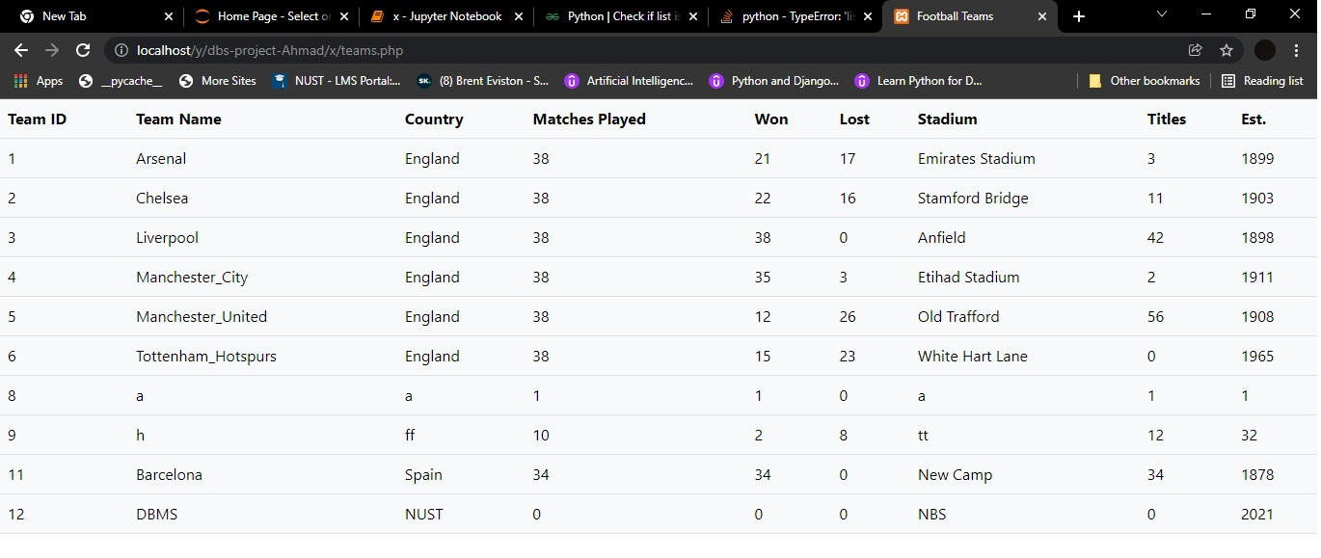
Team Page

Slide 14
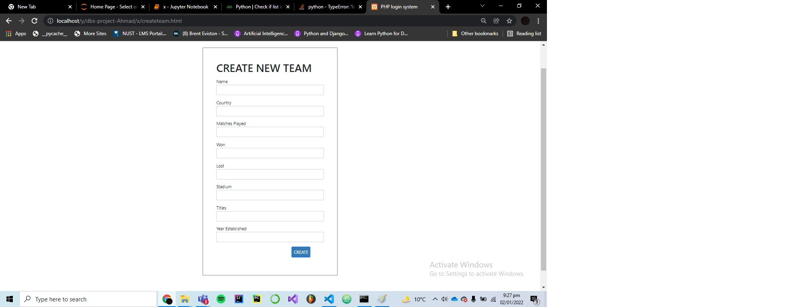
Create Team

Slide 15
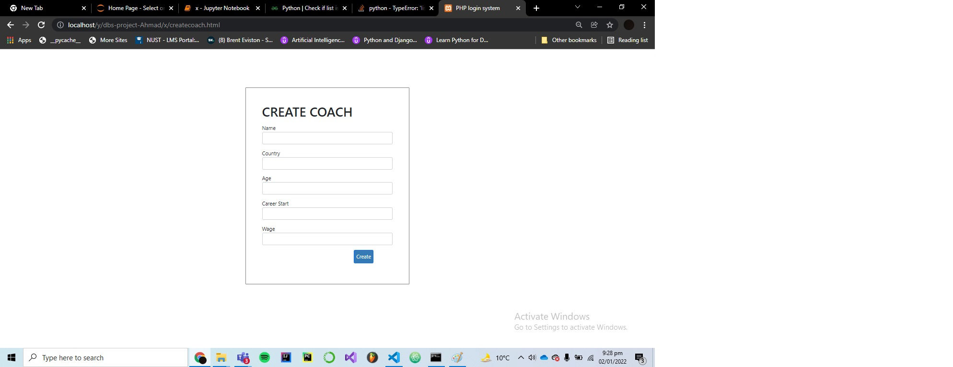
Create Coach

Slide 16
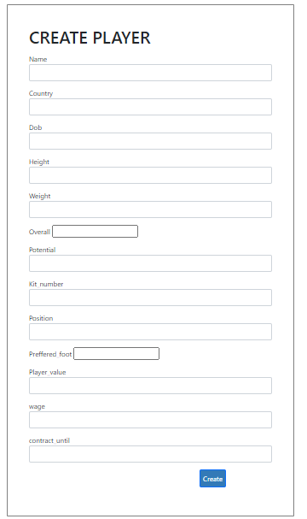
Create Player

Slide 17
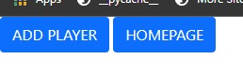
Add Player

Slide 18
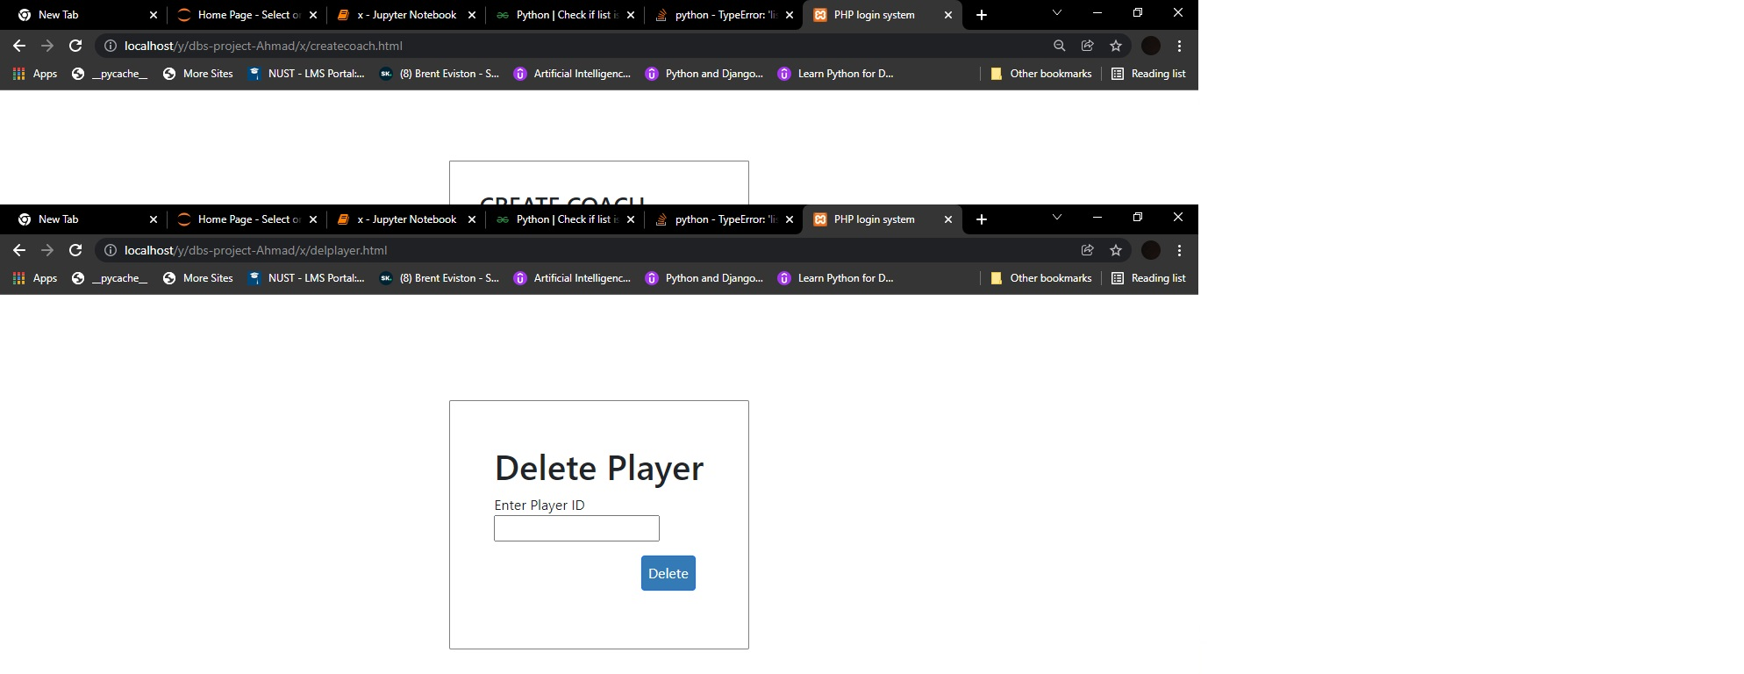
Delete Player

